Slide 1
Attention Is All You Need
Mica Haney
Bailu Zhang
Tam Doan

Slide 2
Introduction
For sequence modeling problems, there are a number of solutions based on recurrent architectures.
RNN, GRU, LSTM
The problem is that the networks are computationally expensive. They require large amounts of storage space and time to train, and scale poorly.
The paper proposes the solution: drop the recurrent architecture, and model dependencies using an attention mechanism.

Slide 3
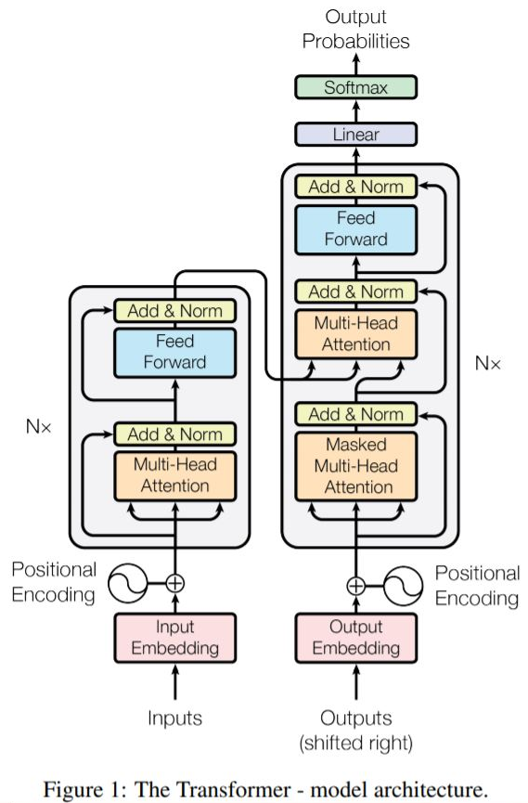

Architecture: Inputs
Embeddings: Map vocabulary to vectors.
Positional Encodings: Contains information about position (since attention drops that information).

Slide 4
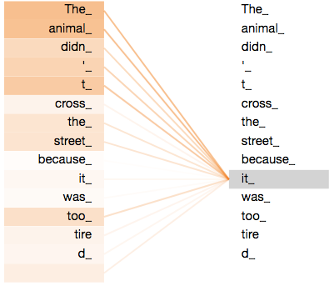
Architecture: Cells
Blue: Encoder Cell(s)
Green: Decoder Cell(s)
Feed-Forward Neural Network: Fully connected, used to combine attention and positional encodings.
Add & Norm: Adds all input vectors, then normalizes data (mean of 0, std. deviation of 1).
Masked Multi-Headed Self-Attention (Decoder Only): Attention, but masks future words out so it can’t look into the future.
Multi-Headed Self-Attention: Computes how closely associated words are.

Slide 5
Architecture: Output
Linear: Fully connected neural network that projects decoder output to logits vector. Logits vector matches target language.
Softmax: Converts logits vector to probabilities, highest probability is selected. The corresponding word is the prediction.

Slide 6
Training
Model trained on 8 NVIDIA P100 GPUs. Training time for base models: 〜12 hours.
EN-DE: WMT 2014 English-German dataset 4.5 Million Sentence Pairs 37000 Tokens Total
EN-FR: WMT 2014 English-French Dataset 36 Million Sentences 32000 Word-Piece Vocabulary
Batches contained sentence pairs with approximately 25000 source and target tokens.

Slide 7
Training
Optimizer: The researchers used the Adam optimizer with β₁ = 0.9, β₂ = 0.98 and ∊ = 10⁻⁹ . The learning rate varied according to the below formula.
lrate = d ^{−0.5} model · min(step_num^{−0.5} , step_num · warmup_steps^{−1.5} )
Dropout: Dropout is applied to the output of each sub-layer. Dropout is also applied to the sum of the positional encodings and embeddings. Dropout is performed at a rate of P_{drop} = 0.1.
Label Smoothing: Value of ∊_{ls} = 0.1, applied during training.

Slide 8
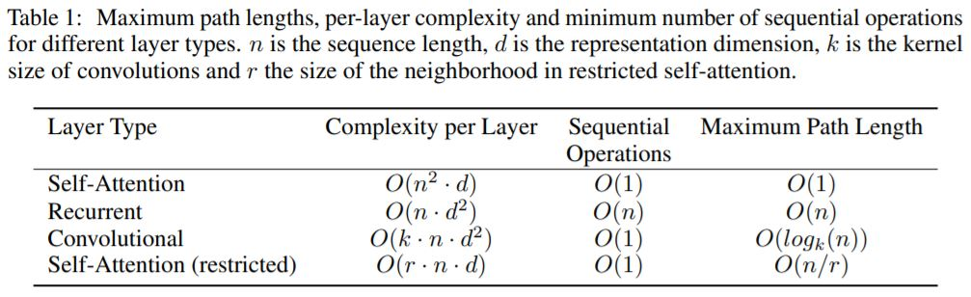
Complexity Comparison
On average: n < d, k < n, and r < n.

Slide 9
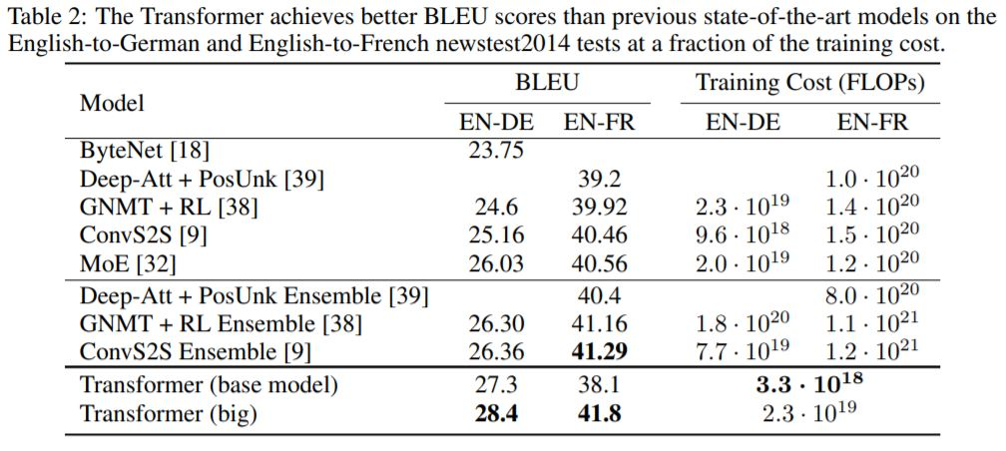
Results

Slide 10
Conclusion
The transformer model achieved state-of-the-art results on the EN-DE and EN-FR tasks. These results are still comparable to (and in some cases still are) the current state-of-the-art.
This is achieved with significant reductions in computational costs, for space, complexity, and time.
Overall the transformer is an effective sequence modeling technique with major advantages over traditional recurrent architectures, making an important contribution to science.

Slide 11
References
Attention Is All You Need (https://arxiv.org/pdf/1706.03762.pdf)
The Illustrated Transformer (http://jalammar.github.io/illustrated-transformer/)
Language Models are Few-Shot Learners (https://arxiv.org/abs/2005.14165)

Slide 12
Any Questions?

